Slide 1
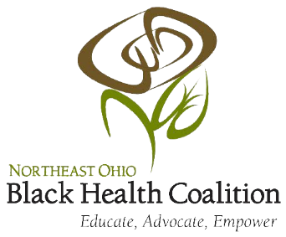
The Benefits of Urban CPR Training in Northeast Ohio African-American Communities

Slide 2
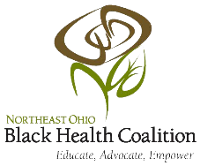
Why Bystanders need to know CPR
Over 359,000 people suffered out-of-hospital cardiac arrests in 2013
9/10 people who suffer a cardiac arrest die
In a seven-year study of 14,000 people who suffered out-of-hospital cardiac arrests, 29% (4060) received life-saving CPR from bystanders

Slide 3
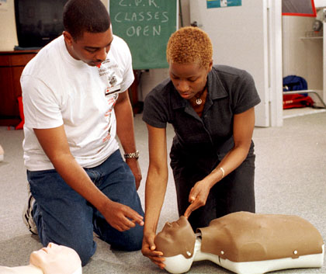
Disparities in the African American Community
Black women are the highest risk group for cardiac arrest
Residents of low-income, black neighborhoods are 50% less likely to receive CPR than residents of high-income, white neighborhoods

Slide 4
Barriers to CPR Administration
Reasons people do not act
Fear of cross-infection from mouth-to-mouth contact
Fear of liability
Lack of confidence in performing CPR correctly in real-life situations
Societal and Economic Barriers to CPR Training
Resource-dependent training
Costly ($25-$100 per session)
Takes several hours to complete
Transportation to training

Slide 5
Solution to Lessening Disparate CPR Training
Free training sessions held in schools and workplaces in Northeast Ohio
Eliminates cost for lower income households
Flexible scheduling around school and work activities
No added transportation costs
Hands-only CPR training
Free training sessions will be held throughout Cleveland, Elyria, Warren, and Akron in one high-profile day

Slide 6
Works Cited
"CPR Training Lacking in Communities That Need It Most | Nursing News, Stories & Articles." Nurse.com. n.p., 18 Nov. 2013. Web. 22 Oct. 2016.
Hsieh, Arthur. "Bystander CPR: A Key Link in the Chain of Survival." www.boundtreeuniversity.com. N.p., 31 May 2016. Web. 22 Oct. 2016.
McGill, Natalie. "CPR Lessons Expand to Minority, Low-income US Communities: Providing Assistance Where Needed Most." (n.d.): n. pag. The Nation's Health: A Publication of the American Public Health Association. Web. 22 Oct. 2016.

